Slide 1

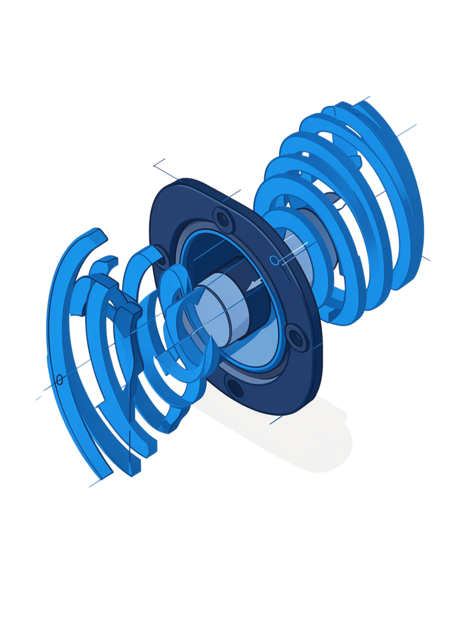

X’O Code 2026
SonicCast – Acoustic One-to-Many Communication
Project Name: SonicCast | Team Name: Sparkz
Team Members
Institution
Selvamuthukkumaran K
Salma A R
Department: Information Technology
College: Manakula Vinayagar Institute of Technology
Notes:
1

Slide 2
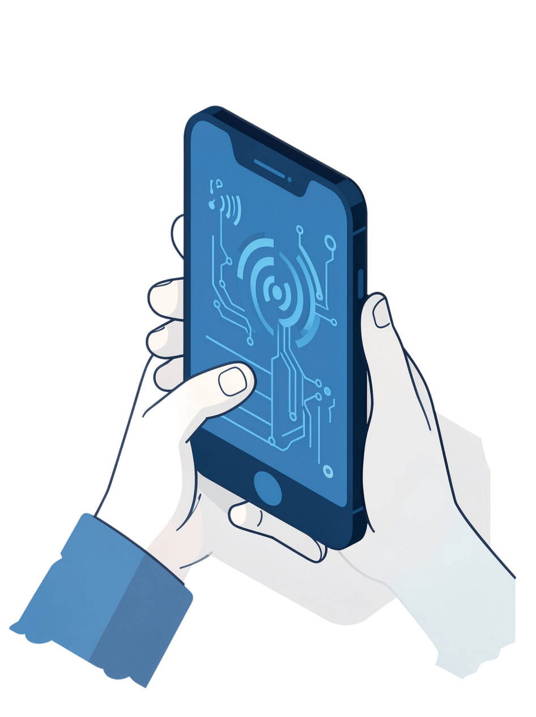
Problem Statement
Most smartphone communication systems depend on Internet, Wi-Fi, Bluetooth, or mobile networks.
Communication becomes difficult when network connectivity is unavailable.
In emergency, remote, or infrastructure-limited environments, conventional communication methods may fail.
There is a need for a simple, offline, short-range communication method using hardware already available in smartphones.
One sender should be able to communicate with multiple nearby receivers simultaneously.
Notes:
2

Slide 3

SonicCast – Proposed Solution
SonicCast is an offline acoustic communication system that uses smartphone speakers and microphones to transmit data through sound.
Encode & CRC
4-FSK Modulate
Acoustic Tx/Rx
Demod & Verify
Notes:
3

Slide 4

Approach / Methodology
01
02
Message Creation
Packet Formation
User enters a message through the React interface.
Message is converted into a structured packet: Header, Length, Sequence Number, Payload, CRC-16.
03
04
Synchronization
4-FSK Modulation
A preamble and synchronization sequence help receivers detect the beginning of a transmission.
The digital data is converted into four different audio frequencies.
05
06
Acoustic Transmission
Reception & Decoding
The sender uses Android AudioTrack to produce the sound through the speaker.
Receiver phones capture sound using AudioRecord and demodulate the signal.
07
08
Error Detection
Reliability & ACK
CRC-16 verifies whether the received packet is correct.
Incorrect or lost packets trigger retransmission. Receivers send an acoustic ACK after successful reception.
Notes:
4

Slide 5
Technology & Tools
Development Tools
Component | Technology
Frontend | React
Programming Language | JavaScript
Styling | CSS
Android Packaging | Capacitor
Native Layer | Kotlin
Speaker Output | Android AudioTrack
Microphone Input | Android AudioRecord
Modulation | 4-FSK
Synchronization | Preamble + Sync Detection
Error Detection | CRC-16
Error Recovery | Retransmission + Optional FEC
Receiver Confirmation | Acoustic ACK
Visual Studio Code
Node.js & npm
Android Studio
Android SDK
Kotlin
Gradle
JDK 17
Notes:
5

Slide 6
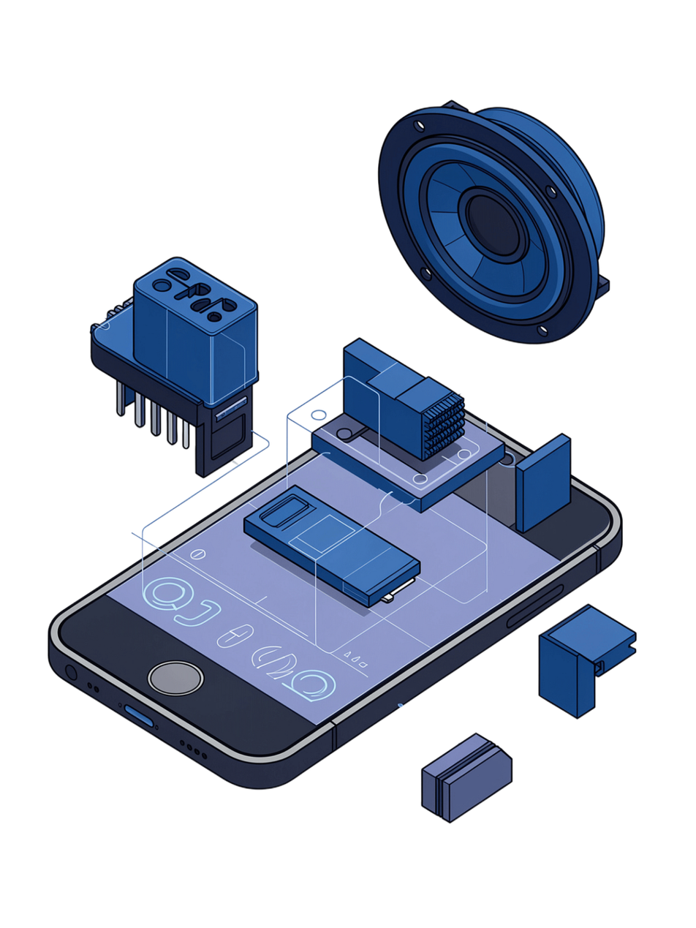
Feasibility
Technical Feasibility
Operational Feasibility
Uses existing smartphone hardware
No special communication hardware required
Android native APIs for speaker and microphone
React + Capacitor enables cross-platform architecture with native Android integration
Simple Sender and Receiver interfaces
Works locally without network infrastructure
Multiple nearby phones can listen to the same acoustic broadcast
Economic Feasibility
No server or cloud infrastructure
No paid communication service
No external hardware required
Development using commonly available software tools
Notes:
6

Slide 7
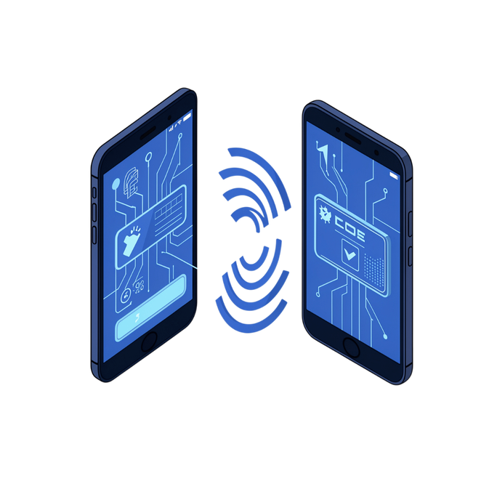
Expected Output / MVP
The MVP should demonstrate:
Sender
Enter a text message.
Broadcast the message acoustically.
Show transmission status.
Receiver
Listen through the microphone.
Detect the acoustic signal.
Decode the packet.
Verify CRC.
Display the received message.
Send an acoustic ACK.
Example
Sender: "Exam starts at 10 AM"
Receivers:
✓ Message received
✓ CRC verified
✓ ACK sent
Notes:
7

Slide 8






Innovation & Impact
Innovation
What makes SonicCast different?
SonicCast transforms the smartphone's existing Speaker + Microphone into a short-range digital communication channel.
No Internet required
No Wi-Fi required
Potential Applications
Emergency communication
Offline classroom announcements
Local device-to-device messaging
Remote or low-connectivity environments
Disaster-response experiments
Acoustic networking research
No Bluetooth required
No backend server
No database
No external hardware
Notes:
9

Slide 9

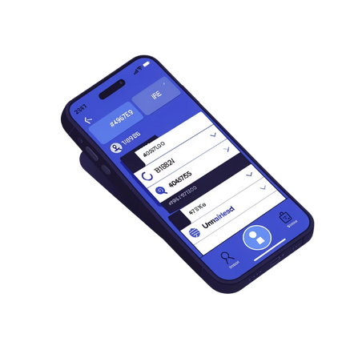
Team Roles
Selvamuthukkumaran K
Salma A R
TECHNICAL / SYSTEM DEVELOPMENT
ANDROID / UI & DOCUMENTATION
React frontend development
JavaScript application logic
Packet encoding and decoding
CRC-16 implementation
4-FSK communication logic
System integration and testing
React UI and CSS design
Capacitor Android integration
Kotlin native audio implementation
AudioTrack / AudioRecord integration
Testing and debugging
Documentation and presentation preparation
Team Responsibility: Both members: Research • Testing • Integration • Problem Solving • Final Demonstration

Slide 10

Conclusion & Future Scope
An offline acoustic one-to-many communication system for smartphones.
Core Technology
React + JavaScript + CSS → Capacitor → Kotlin → 4-FSK Acoustic Communication → CRC-16 + ACK + Retransmission
Future Scope
Improve communication range and increase transmission speed
Add stronger FEC algorithms and improve noise filtering
Support larger data packets and multiple message types
Improve automatic receiver detection and optimize performance across different smartphone models
"SonicCast — Connecting smartphones through sound, even without a network."
Team Sparkz | Manakula Vinayagar Institute of Technology
Notes:
10

